Slide 1
Chapter 4
The Relational Model
Pearson Education © 2009

Slide 2
Chapter 4 - Objectives
Terminology of relational model.
How tables are used to represent data.
Connection between mathematical relations and relations in the relational model.
Properties of database relations.
How to identify CK, PK, and FKs.
Meaning of entity integrity and referential integrity.
Purpose and advantages of views.
Pearson Education © 2009

Slide 3
Relational Model Terminology
A relation is a table with columns and rows.
Only applies to logical structure of the database, not the physical structure.
Attribute is a named column of a relation.
Domain is the set of allowable values for one or more attributes.
Pearson Education © 2009

Slide 4
Relational Model Terminology
Tuple is a row of a relation.
Degree is the number of attributes in a relation.
Cardinality is the number of tuples in a relation.
Relational Database is a collection of normalized relations with distinct relation names.
Pearson Education © 2009

Slide 5
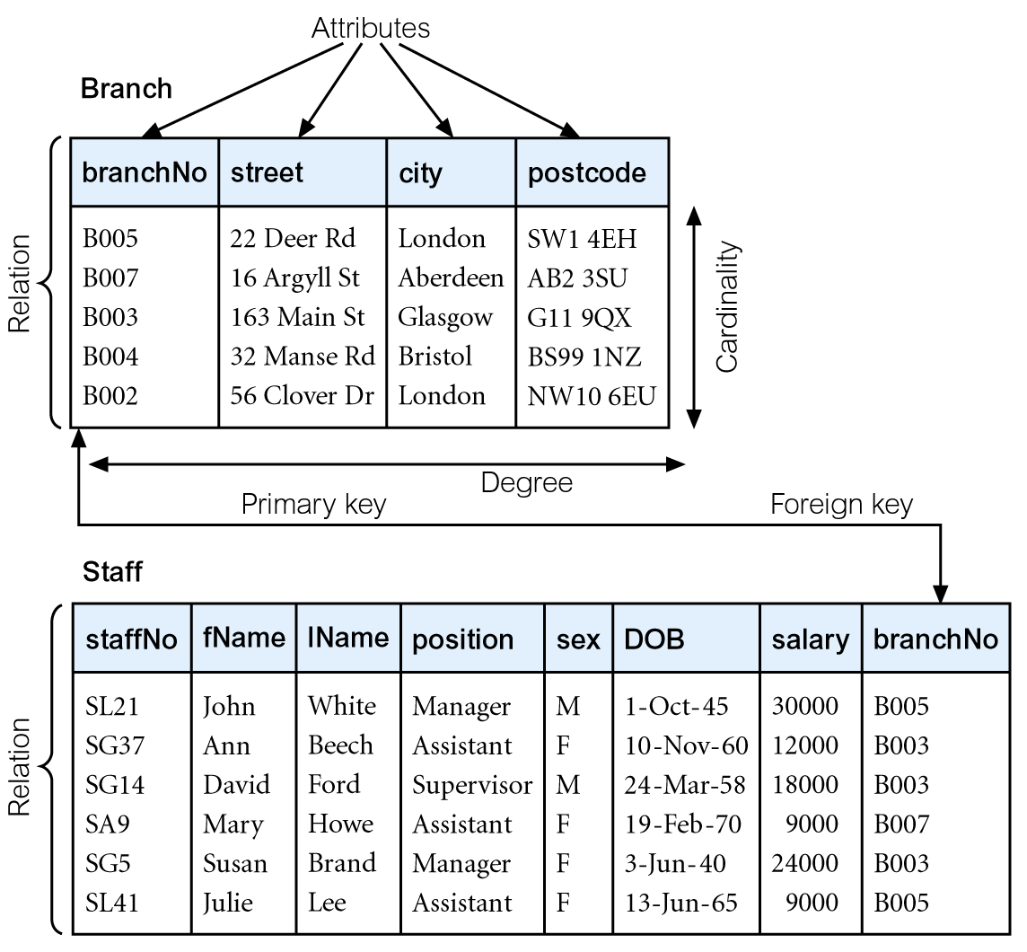
Instances of Branch and Staff Relations
Pearson Education © 2009

Slide 6
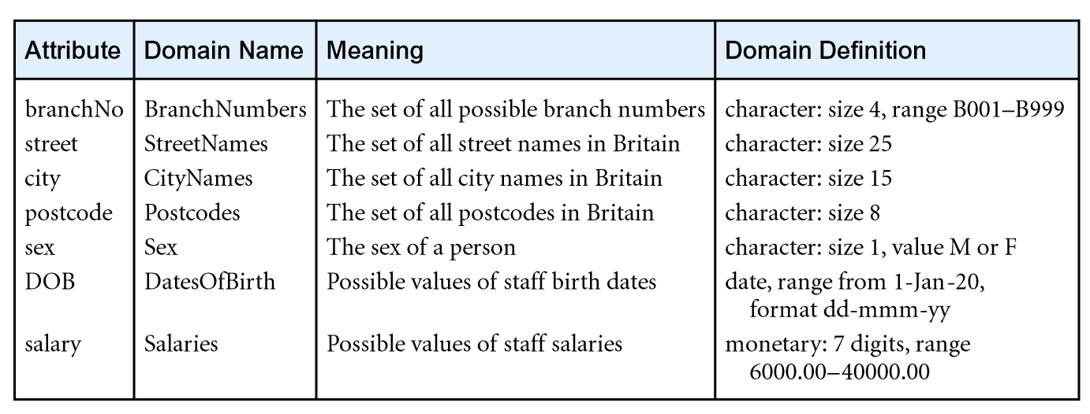
Examples of Attribute Domains
Pearson Education © 2009

Slide 7
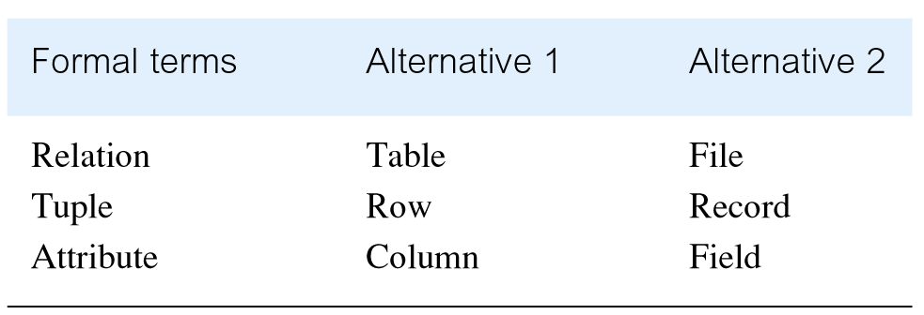
Alternative Terminology for Relational Model
Pearson Education © 2009

Slide 8
Mathematical Definition of Relation
Consider two sets, D₁ & D₂, where D₁ = {2, 4} and D₂ = {1, 3, 5}.
Cartesian product, D₁ × D₂, is set of all ordered pairs, where first element is member of D₁ and second element is member of D₂.
D₁ × D₂ = {(2, 1), (2, 3), (2, 5), (4, 1), (4, 3), (4, 5)}
Alternative way is to find all combinations of elements with first from D₁ and second from D₂.
Pearson Education © 2009

Slide 9
Mathematical Definition of Relation
Any subset of Cartesian product is a relation; e.g.
R = {(2, 1), (4, 1)}
May specify which pairs are in relation using some condition for selection; e.g.
second element is 1:
R = {(x, y) | x ∈D₁, y ∈D₂, and y = 1}
first element is always twice the second:
S = {(x, y) | x ∈D₁, y ∈D₂, and x = 2y}
Pearson Education © 2009

Slide 10
Mathematical Definition of Relation
Consider three sets D₁, D₂, D₃ with Cartesian Product D₁ × D₂ × D₃; e.g.
D₁ = {1, 3} D₂ = {2, 4} D₃ = {5, 6}
D₁ × D₂ × D₃ = {(1,2,5), (1,2,6), (1,4,5), (1,4,6), (3,2,5), (3,2,6), (3,4,5), (3,4,6)}
Any subset of these ordered triples is a relation.
Pearson Education © 2009

Slide 11
Mathematical Definition of Relation
Cartesian product of n sets (D₁, D₂, . . ., D_{n}) is:
D₁ × D₂ × . . . × D_{n} = {(d₁, d₂, . . . , d_{n}) | d₁ ∈D₁, d₂ ∈D₂, . . . , d_{n}∈D_{n}}
usually written as:
n
XD_{i}
^{i = 1}
Any set of n-tuples from this Cartesian product is a relation on the n sets.
Pearson Education © 2009

Slide 12
Database Relations
Relation schema
Named relation defined by a set of attribute and domain name pairs.
Relational database schema
Set of relation schemas, each with a distinct name.
Pearson Education © 2009

Slide 13
Properties of Relations
Relation name is distinct from all other relation names in relational schema.
Each cell of relation contains exactly one atomic (single) value.
Each attribute has a distinct name.
Values of an attribute are all from the same domain.
Pearson Education © 2009

Slide 14
Properties of Relations
Each tuple is distinct; there are no duplicate tuples.
Order of attributes has no significance.
Order of tuples has no significance, theoretically.
Pearson Education © 2009

Slide 15
Relational Keys
Superkey
An attribute, or set of attributes, that uniquely identifies a tuple within a relation.
Candidate Key
Superkey (K) such that no proper subset is a superkey within the relation.
In each tuple of R, values of K uniquely identify that tuple (uniqueness).
No proper subset of K has the uniqueness property (irreducibility).
Pearson Education © 2009

Slide 16
Relational Keys
Primary Key
Candidate key selected to identify tuples uniquely within relation.
Alternate Keys
Candidate keys that are not selected to be primary key.
Foreign Key
Attribute, or set of attributes, within one relation that matches candidate key of some (possibly same) relation.
Pearson Education © 2009

Slide 17
Integrity Constraints
Null
Represents value for an attribute that is currently unknown or not applicable for tuple.
Deals with incomplete or exceptional data.
Represents the absence of a value and is not the same as zero or spaces, which are values.
Pearson Education © 2009

Slide 18
Integrity Constraints
Entity Integrity
In a base relation, no attribute of a primary key can be null.
Referential Integrity
If foreign key exists in a relation, either foreign key value must match a candidate key value of some tuple in its home relation or foreign key value must be wholly null.
Pearson Education © 2009

Slide 19
Integrity Constraints
General Constraints
Additional rules specified by users or database administrators that define or constrain some aspect of the enterprise.
Pearson Education © 2009

Slide 20
Views
Base Relation
Named relation corresponding to an entity in conceptual schema, whose tuples are physically stored in database.
View
Dynamic result of one or more relational operations operating on base relations to produce another relation.
Pearson Education © 2009

Slide 21
Views
A virtual relation that does not necessarily actually exist in the database but is produced upon request, at time of request.
Contents of a view are defined as a query on one or more base relations.
Views are dynamic, meaning that changes made to base relations that affect view attributes are immediately reflected in the view.
Pearson Education © 2009

Slide 22
Purpose of Views
Provides powerful and flexible security mechanism by hiding parts of database from certain users.
Permits users to access data in a customized way, so that same data can be seen by different users in different ways, at same time.
Can simplify complex operations on base relations.
Pearson Education © 2009

Slide 23
Updating Views
All updates to a base relation should be immediately reflected in all views that reference that base relation.
If view is updated, underlying base relation should reflect change.
Pearson Education © 2009

Slide 24
Updating Views
There are restrictions on types of modifications that can be made through views:
Updates are allowed if query involves a single base relation and contains a candidate key of base relation.
Updates are not allowed involving multiple base relations.
Updates are not allowed involving aggregation or grouping operations.
Pearson Education © 2009

Slide 25
Updating Views
Classes of views are defined as:
theoretically not updateable;
theoretically updateable;
partially updateable.
Pearson Education © 2009

